Slide 1
Commercial/Industrial Waterway Access
Concern & awareness over loss of working waterfront
FIND study to identify potential public sites in each county along east coast of FL
Initial Assessments identified 28 potential sites in Duval
Public Meeting reduced list to 16 sites
Further review by staff resulted in 4 sites where minimal impact on recreational use

Slide 2
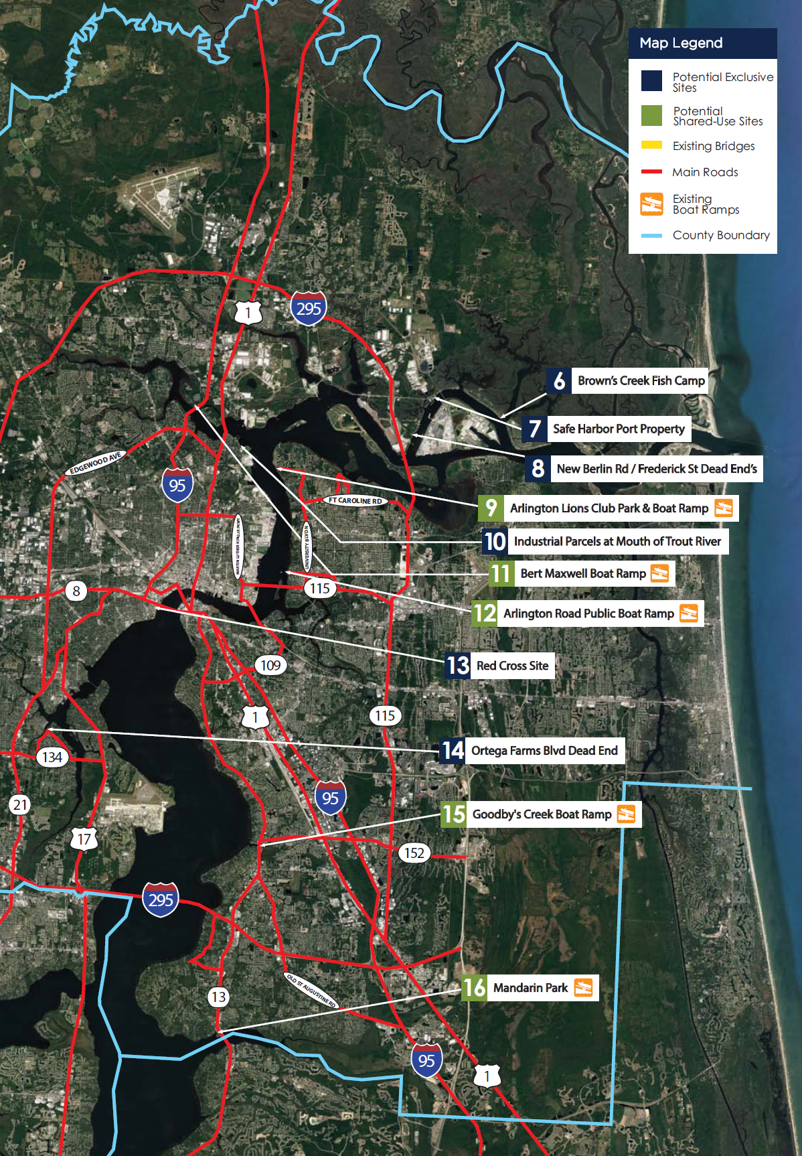
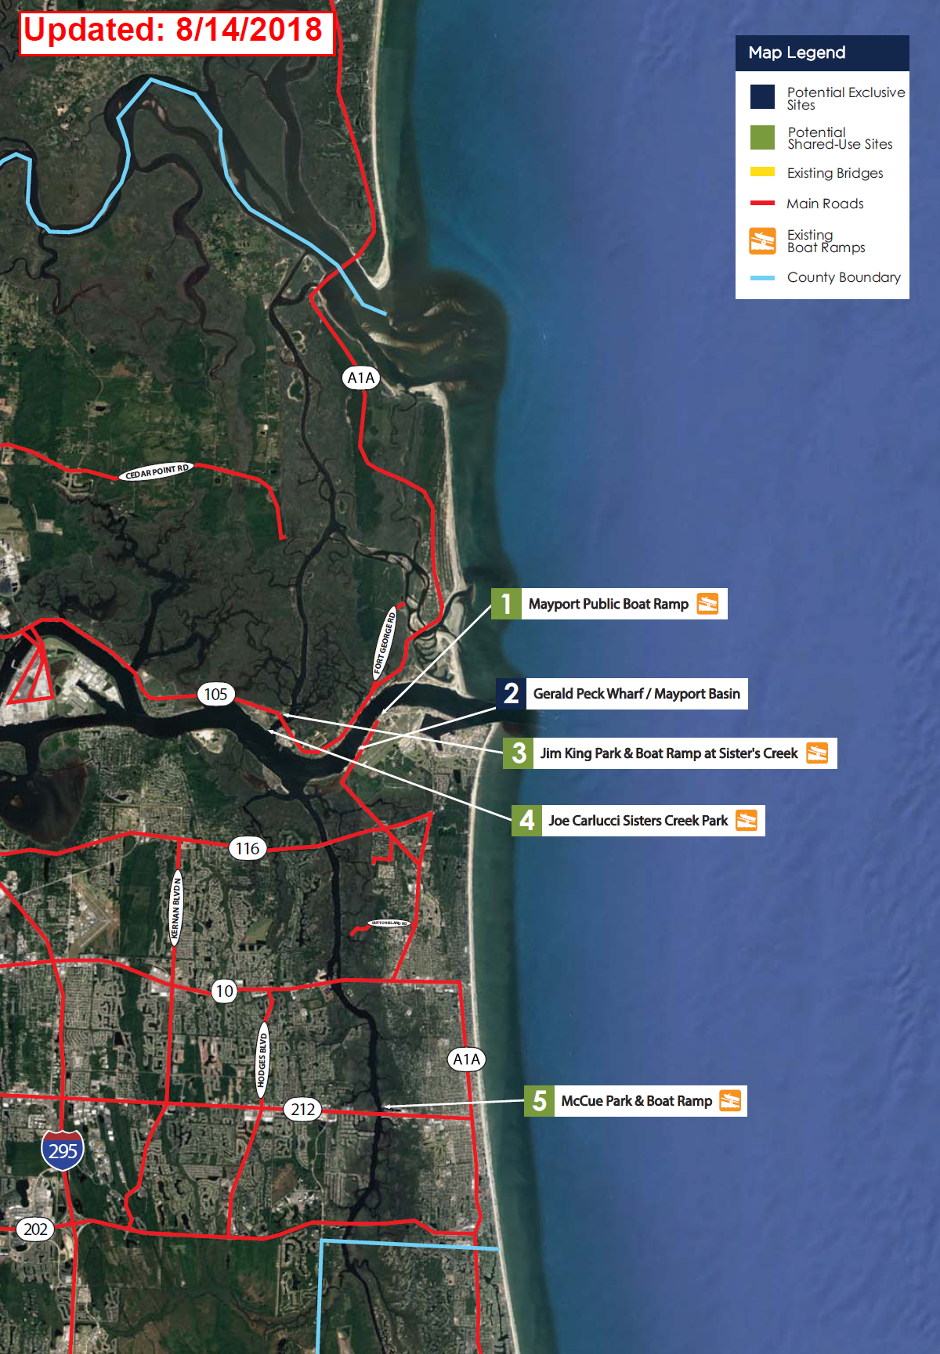

Slide 3
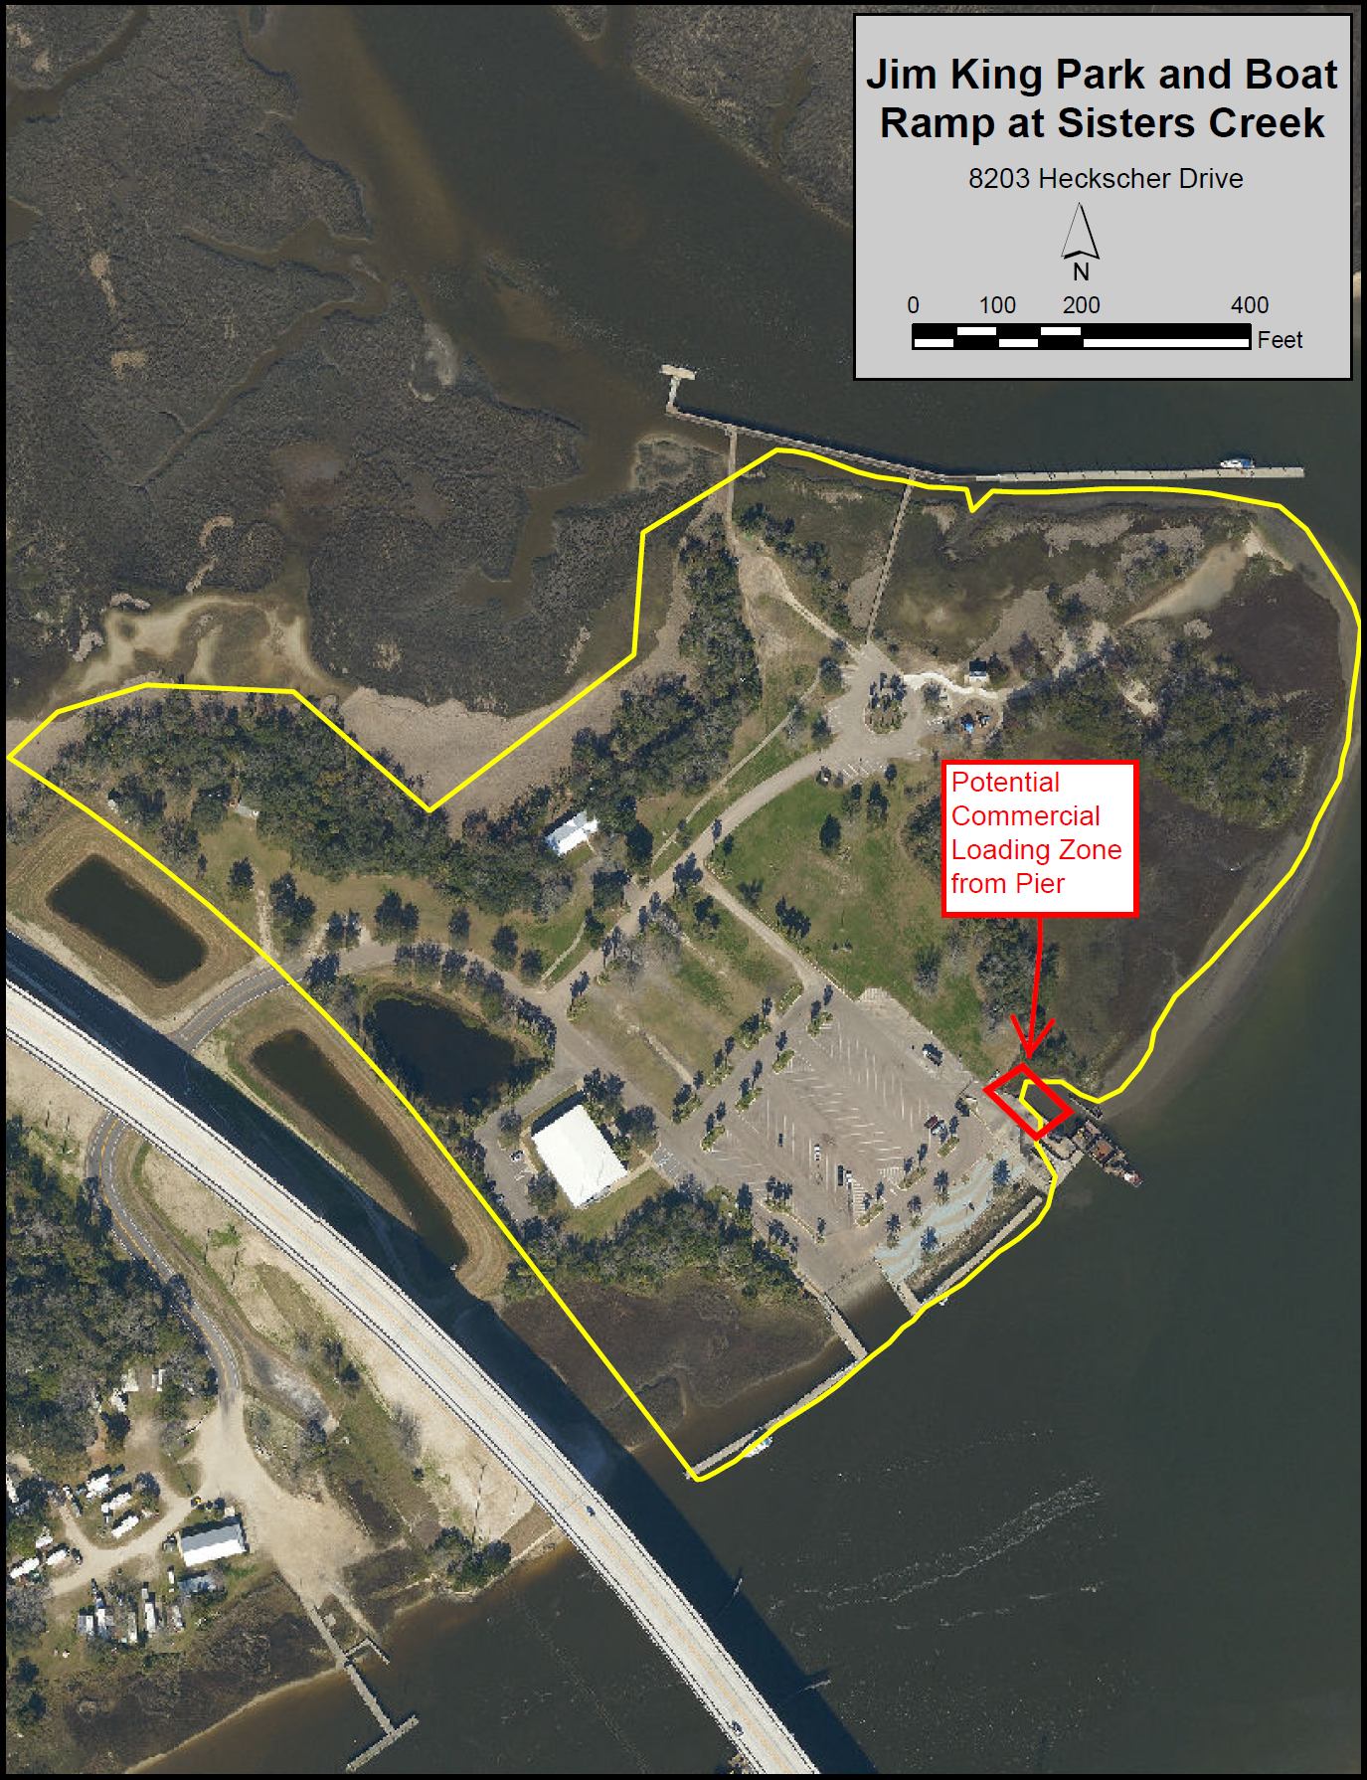
Zoning = Public Buildings and Facilities-1

Slide 4
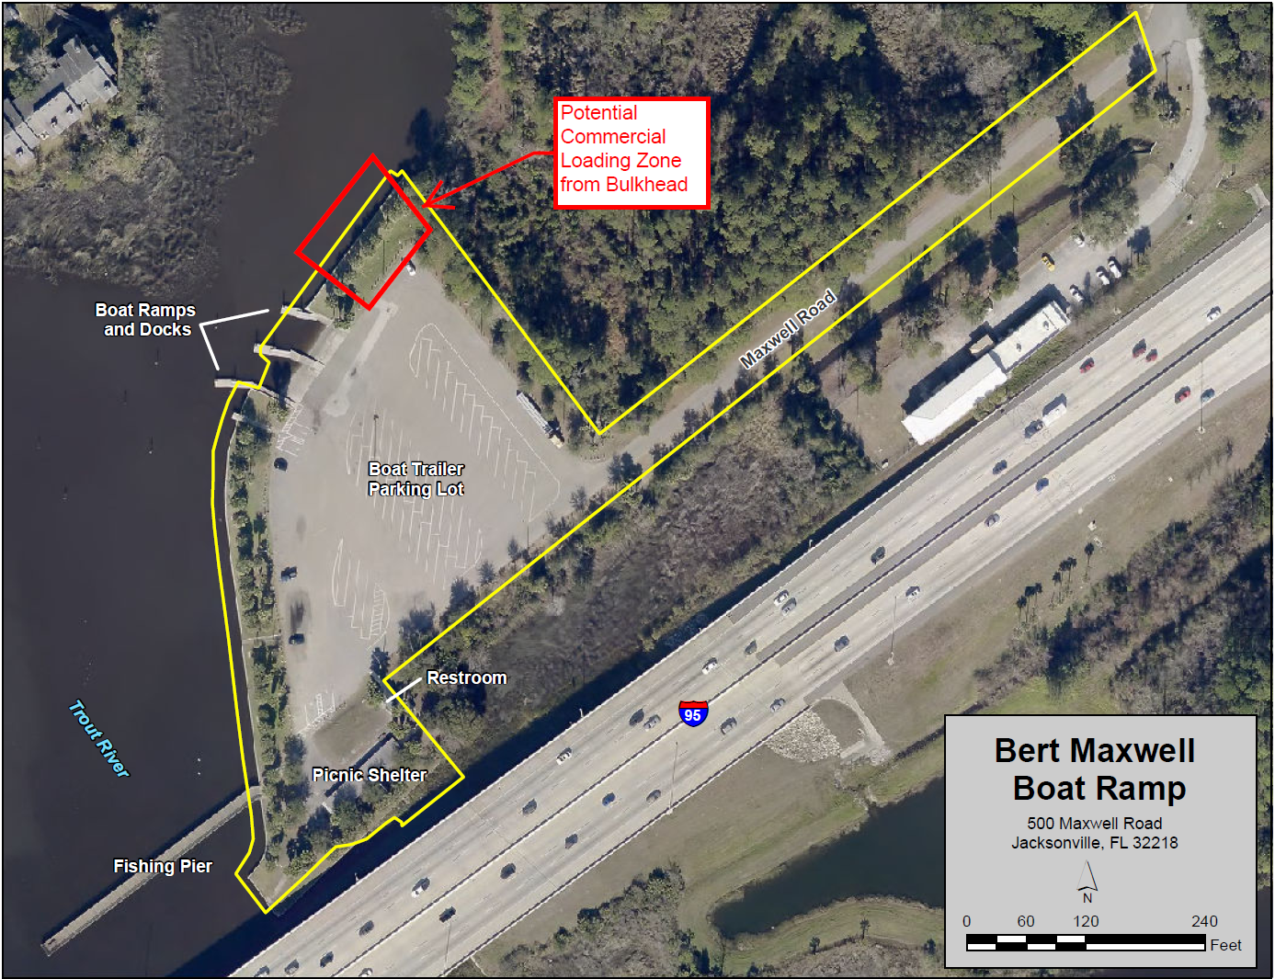
Zoning = Public Buildings and Facilities-1

Slide 5
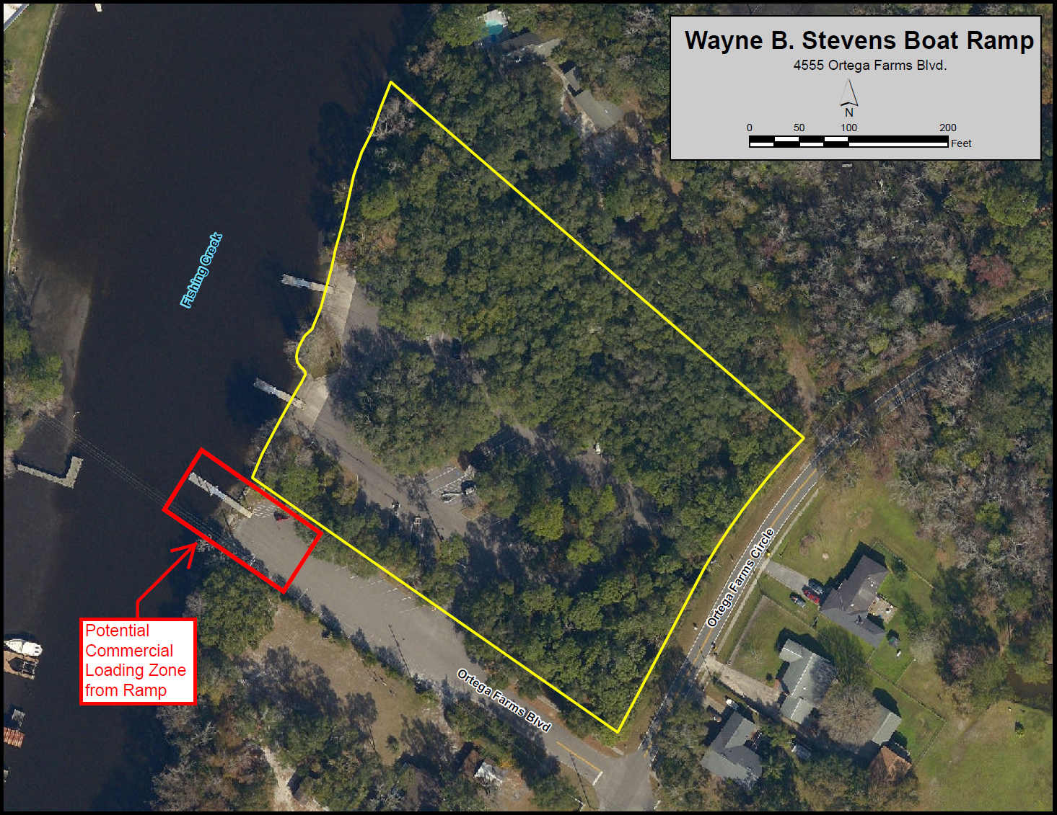
Incompatible Zoning = Residential Low Density-90

Slide 6
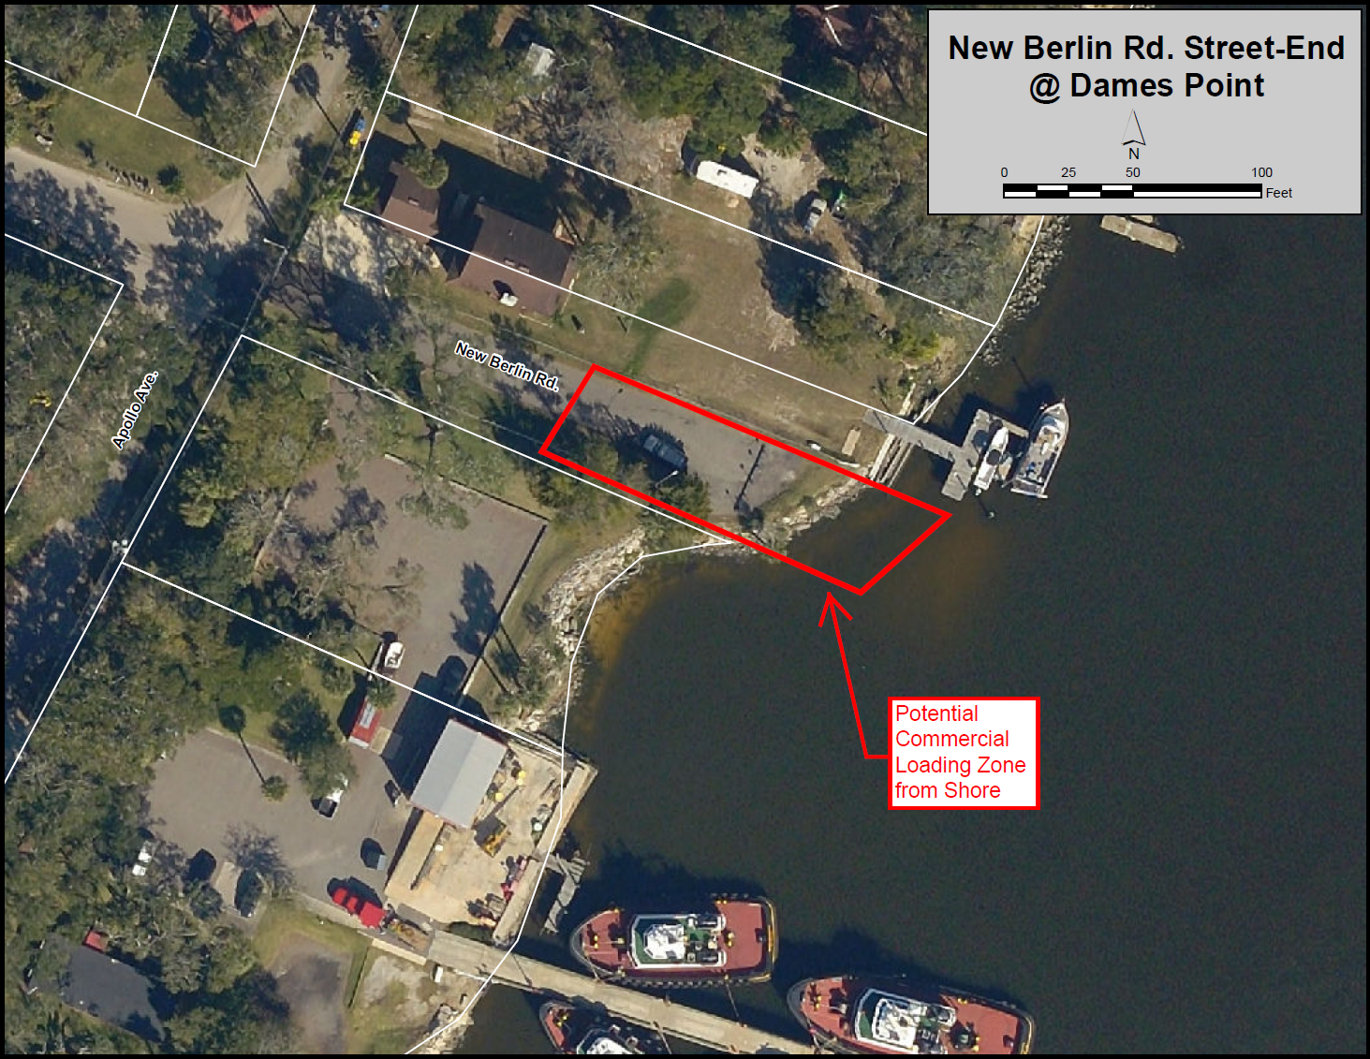
Zoning = Industrial Waterway

Slide 7
JaxPort Option
Port Authority Facilities are available to marine contractors
Contractor must coordinate with one of JaxPort’s terminal operators
Fee required for security escort, must use their labor and crane, wharfage & dockage fees, etc.
Example: 100’x50’ barge loading 20,000 lbs = estimated cost of $4000

Slide 8
Existing Ordinance
Sec. 615.102(a)
Temporary docking at City-owned or leased bulkheads, floating docks, fixed docks or piers shall only be at sites designated by the Director, Recreation and Parks Department, or other authorized official. It shall be unlawful for any boat or vessel to dock at designated areas in excess of the posted time or to dock in such designated area for a purpose other than that authorized by the Director or other authorized official.

Slide 9
If supported, next steps…
Ordinance Code changes to:
clarify what type of commercial use is allowed at public water access facilities
establish process for authorizing marine contractors to load/unload at designated locations
Apply for FIND grant to improve designated commercial access points

Slide 10
Draft Ordinance
Sec. 28.728. – Commercial/industrial use of publically owned waterfront prohibited.
It shall be unlawful for any person to bring alongside or moor a vessel, whether motor-powered or not, upon or adjacent to any waterfront property owned or controlled by the City for the commercial or industrial purpose of loading or unloading materials, except at places and during such hours as may be designated for such use by the Director or designee. Materials include, but are not limited to construction materials and items for the maintenance of vessels. Exception is granted to commercial fishermen and recreational vessels for hire that only use public waterfront property for its intended use of launching and retrieval of vessels in a timely manner.

